Slide 1
Informatica PowerCenter
Lesson 14: Creating a Type 2 Dimension/Version Data Mapping

Slide 2
Lesson Objectives
In this Lesson you will learn about:
  Type 1 & Type 2 Dimension
  Using a Mapping Wizard to create a Type 2 Dimension mapping

Slide 3
14.1. Introduction
Dimensions contains Textual attributes.
  The Type 1 Dimension mapping - Loads a slowly changing dimension table by inserting new dimensions and overwriting existing dimensions.
  i.e. Rows containing changes to existing dimensions are updated in the target by overwriting the existing dimension.
  In the Type 1 Dimension mapping, all rows contain current dimension data and historical data is lost.
Notes:
Use this mapping when you do not you need to keep any previous versions / history of dimensions in the table.

Slide 4
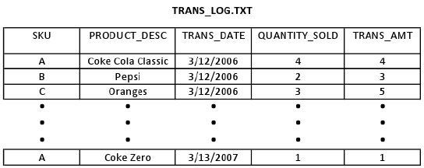
14.1. Type 1 - Example
For example, we have a fact table, FACT_TRANS, containing the sales data for various snack and beverage products and a dimension table,LU_PRODUCT, containing the product descriptions. Over time, however, one of these product descriptions as recorded in the transaction log, TRANS_LOG.TXT,changed, resulting in an SCD that must be processed.
Figure 14.1
contd.

Slide 5
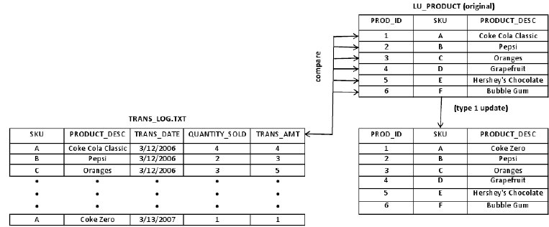
14.1. Type 1 - Example
Prod Desc Changed
Figure 14.2

Slide 6
14.1. Introduction
The Type 2 Dimension/Version Data mapping filters source rows based on user-defined comparisons and inserts both new and changed dimensions into the target.
Changes are tracked in the target table by versioning the primary key and creating a version number for each dimension in the table. When you use this option, the Designer creates two additional fields in the target:
PM_PRIMARYKEY. The Integration Service generates a primary key for each row written to the target.
PM_VERSION_NUMBER. The Integration Service generates a version number for each row written to the target
Notes:
In the Type 2 Dimension/Version Data target, the current version of a dimension has the highest version number and the highest incremented primary key of the dimension.
Use the Type 2 Dimension/Version Data mapping to update a slowly changing dimension table when you want to keep a full history of dimension data in the table. Version numbers and versioned primary keys track the order of changes to each dimension.

Slide 7
14.2. Handling Keys
In a Type 2 Dimension/Version Data mapping, the Integration Service generates a new primary key value for each new dimension it inserts into the target.
An Expression transformation increments key values by 1,000 for new dimensions.
When updating an existing dimension, the Integration Service increments the existing primary key by 1.

Slide 8
14.3. Example
For example, the Integration Service inserts the following new row with a key value of 65,000 since this is the sixty-fifth dimension in the table.
PM_PRIMARYKEY ITEM STYLES
65000 Sandal 5
Contd…

Slide 9
The next time you run the workflow containing the session, the same item has a different number of styles.
The Integration Service creates a new row with updated style information and increases the existing key by 1 to create a new key of 65,001.
Both rows exist in the target, but the row with the higher key version contains current dimension data.
PM_PRIMARYKEY ITEM STYLES
65000 Sandal 5
65001 Sandal 14
Contd…

Slide 10
When you run the workflow again, the Integration Service again increments the key.
The highest key version contains current dimension data.
The target keeps a full history of the item as well as the order in which the versions occurred.
PM_PRIMARYKEY ITEM STYLES
65000 Sandal 5
65001 Sandal 14
65002 Sandal 17

Slide 11
14.4. Numbering Versions
In addition to versioning the primary key, the Integration Service generates a matching version number for each row inserted into the target.
Version numbers correspond to the final digit in the primary key.
New dimensions have a version number of 0.
Notes:
For example, in the data below, the versions are 0, 1, and 2. The highest version number contains the current dimension data.
PM_PRIMARYKEY ITEM STYLES PM_VERSION_NUMBER
65000 Sandal 5 0
65001 Sandal 14 1
65002 Sandal 17 2

Slide 12
14.5. Understanding the Mapping
Selects all rows
Caches the existing target as a lookup table
Compares logical key columns in the source against corresponding columns in the target lookup table
Compares source columns against corresponding target columns if key columns match
Flags new rows and changed rows
Creates two data flows: one for new rows, one for changed rows
Generates a primary key and version number for new rows
Inserts new rows to the target
Increments the primary key and version number for changed rows
Inserts changed rows in the target
Notes:
The Type 2 Dimension/Version Data mapping uses a Lookup and an Expression transformation to compare source data against existing target data. When you step through the Slowly Changing Dimensions Wizard, you enter the lookup conditions (source key columns) and source columns that you want the Integration Service to compare against the existing target.
For each source row :
without a matching primary key in the target, the Expression transformation marks the row new.
with a matching primary key in the target, the Expression compares user-defined source and target columns. If those columns do not match, the Expression marks the row changed.
The mapping then splits into two separate data flows.
The first data flow uses the Filter transformation, FIL_InsertNewRecord, to filter out existing rows. The Filter transformation passes only new rows to the UPD_ForceInserts Update Strategy transformation. UPD_ForceInserts inserts new rows to the target. A Sequence Generator creates a primary key for each row. The Expression transformation, EXP_KeyProcessing_InsertNew, increases the increment between keys by 1,000 and creates a version number of 0 for each new row.
In the second data flow, the FIL_InsertChangedRecord Filter transformation allows only changed rows to pass to the Update Strategy transformation, UPD_ChangedInserts. UPD_ChangedInserts inserts changed rows to the target. The Expression transformation, EXP_KeyProcessing_InsertChanged, increments both the existing key and the existing version number by one.

Slide 13
Summary
This Lesson gives knowledge about Creating a Type 2 Dimension/Version Data Mapping

Slide 14
Review Question
Question 1: In a Type 2 Dimension/Version Data Mapping, new dimensions have a version number __.
Question 2: The Type 2 Dimension/Version Data ________ both new and changed dimensions into the target.
  Option 1: Inserts
  Option 2: Deletes
  Option 3: Updates

